Slide 1
A faster rate in the framework of Gradient Descent
Andrei Caraman Simone Piperno Leonardo Skerl
Gianmarco Ursini

Slide 2
Runge Kutta Integrators
In numerical analysis, the Runge–Kutta methods are a family of implicit and explicit iterative methods used in temporal discretization for the approximate solutions of ODEs (ordinary differential equations).

Slide 3
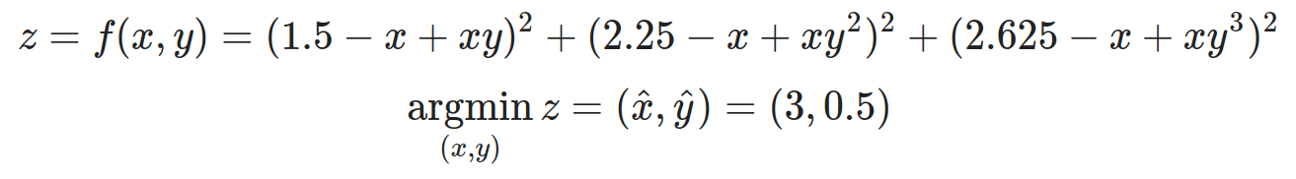
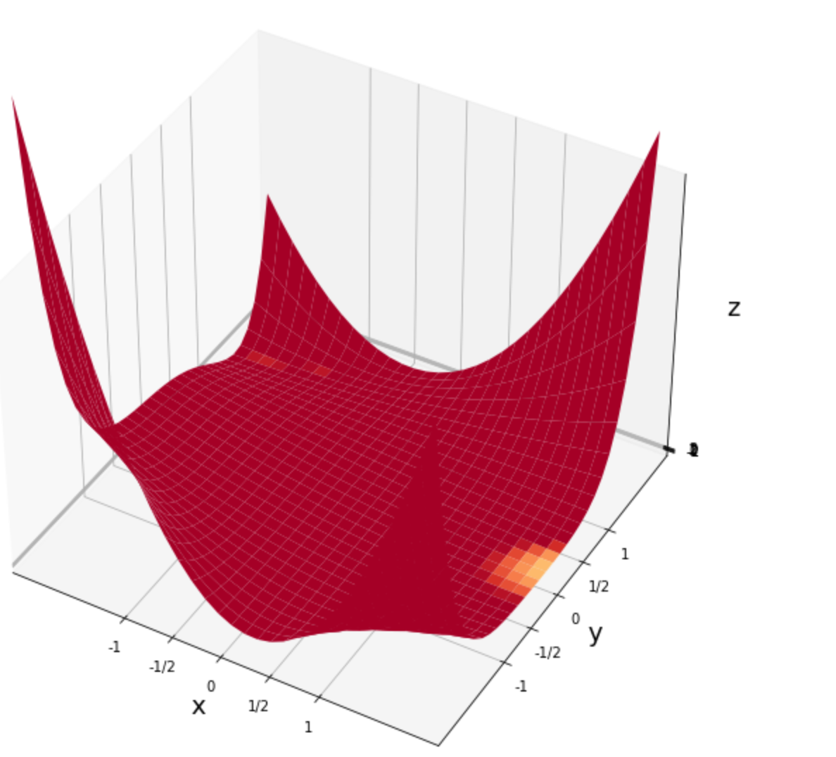
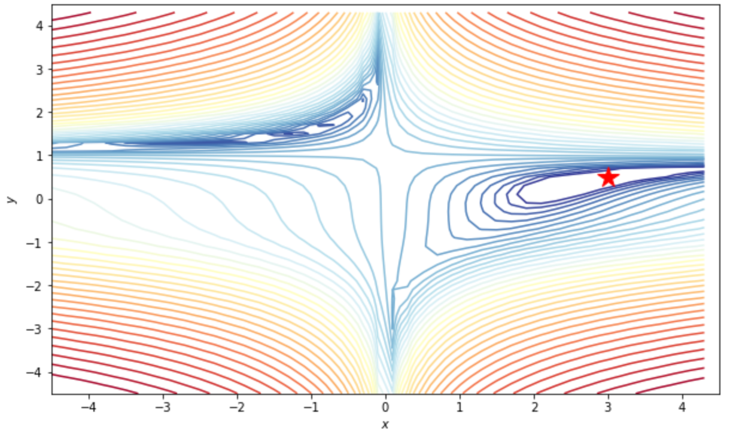
Beales Function

Slide 4
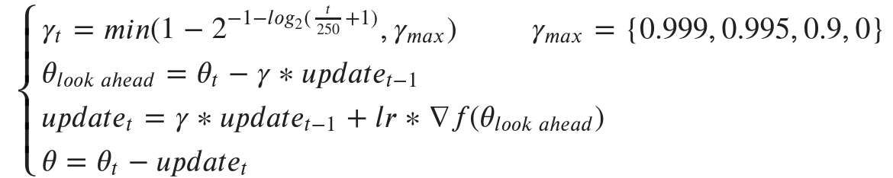
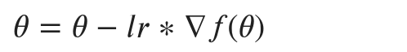
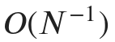
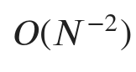
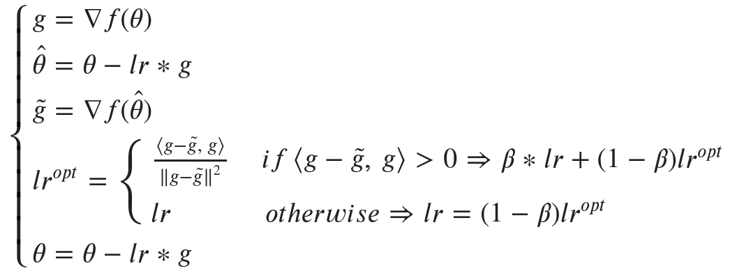
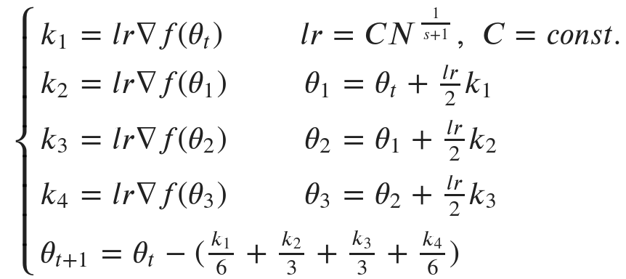
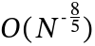
Vanilla descent
NAG
RUNGE-KUTTA 2
Adaptive L.R.
RUNGE-KUTTA 4
Notes:
Runge Kutta integrators in gradient descent field with learning rate computed in a suitable way (in the formula) converges to the optimal solution at the rate O(N^-2), which for Runge Kutta 4, that we implemented, is O(N^-8/5).
This method introduces a new local flatness condition for the objective function, under which Runge-Kutta discretization obtains convergence rates even faster than O(N^-2), without requiring high-order integrators. In particular, if the objective is locally flat around a minimum, by using only gradient information we can obtain a convergence rate of O(-p), where p quantifies the degree of local flatness.
<numero>

Slide 5
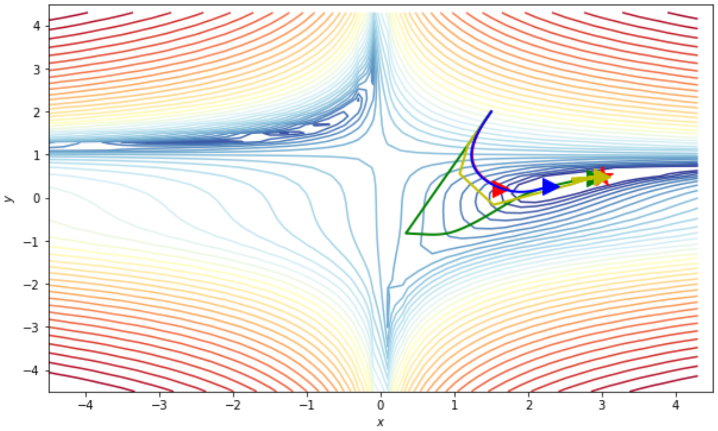
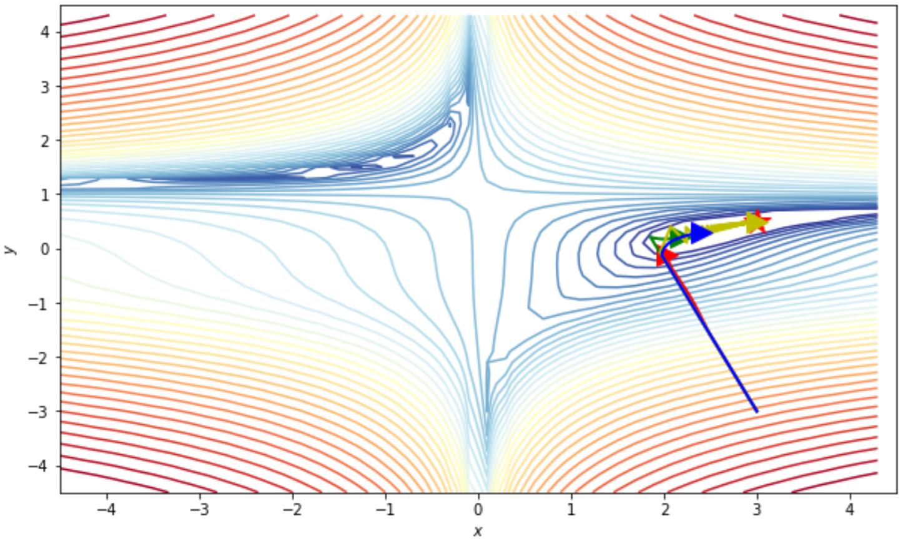
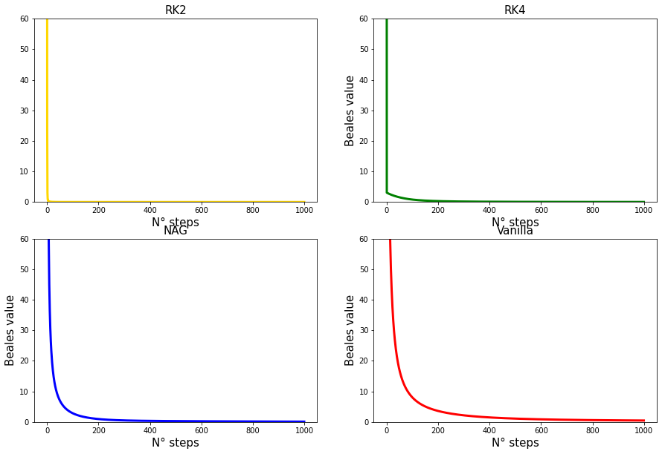
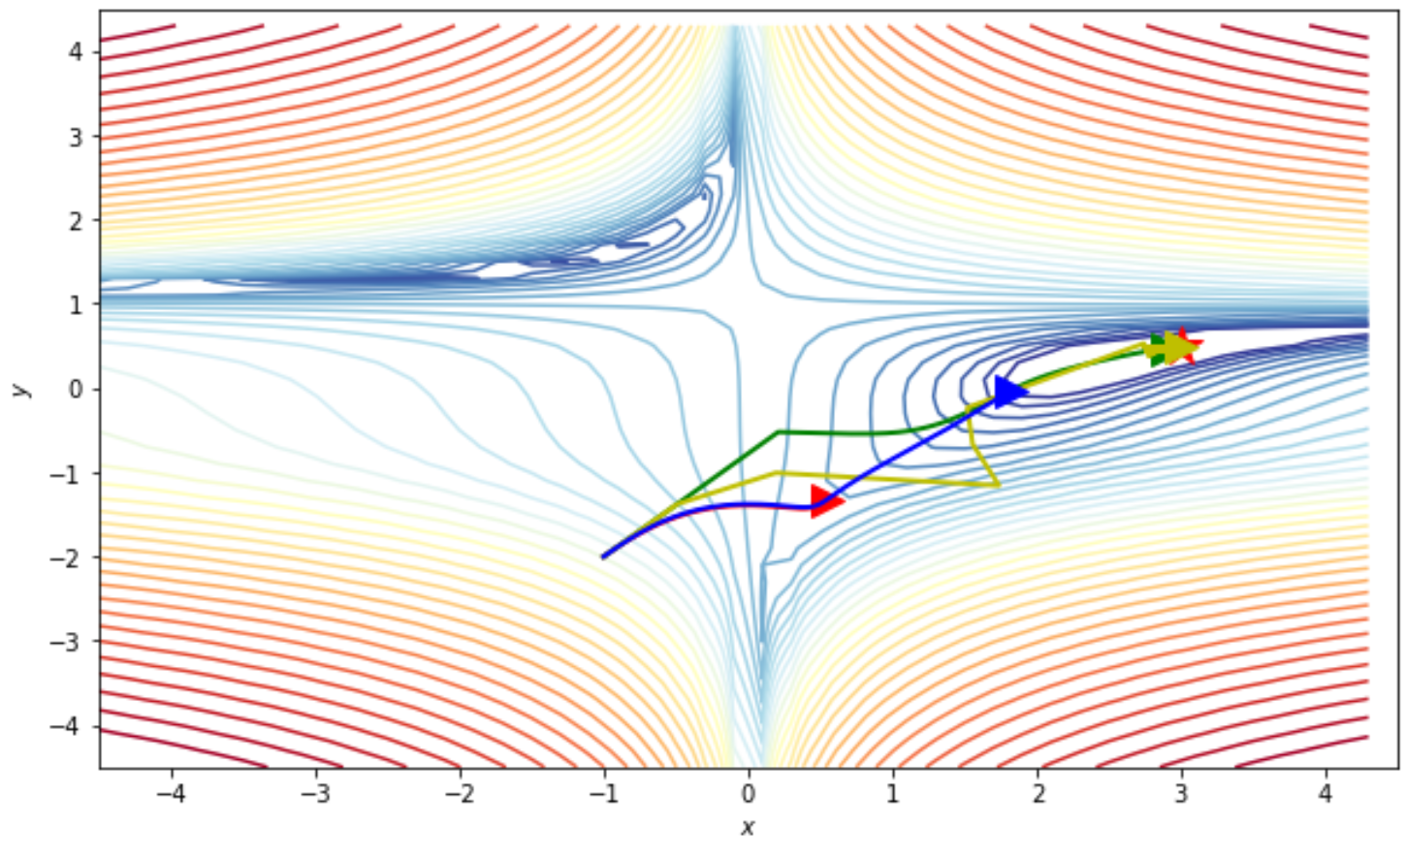
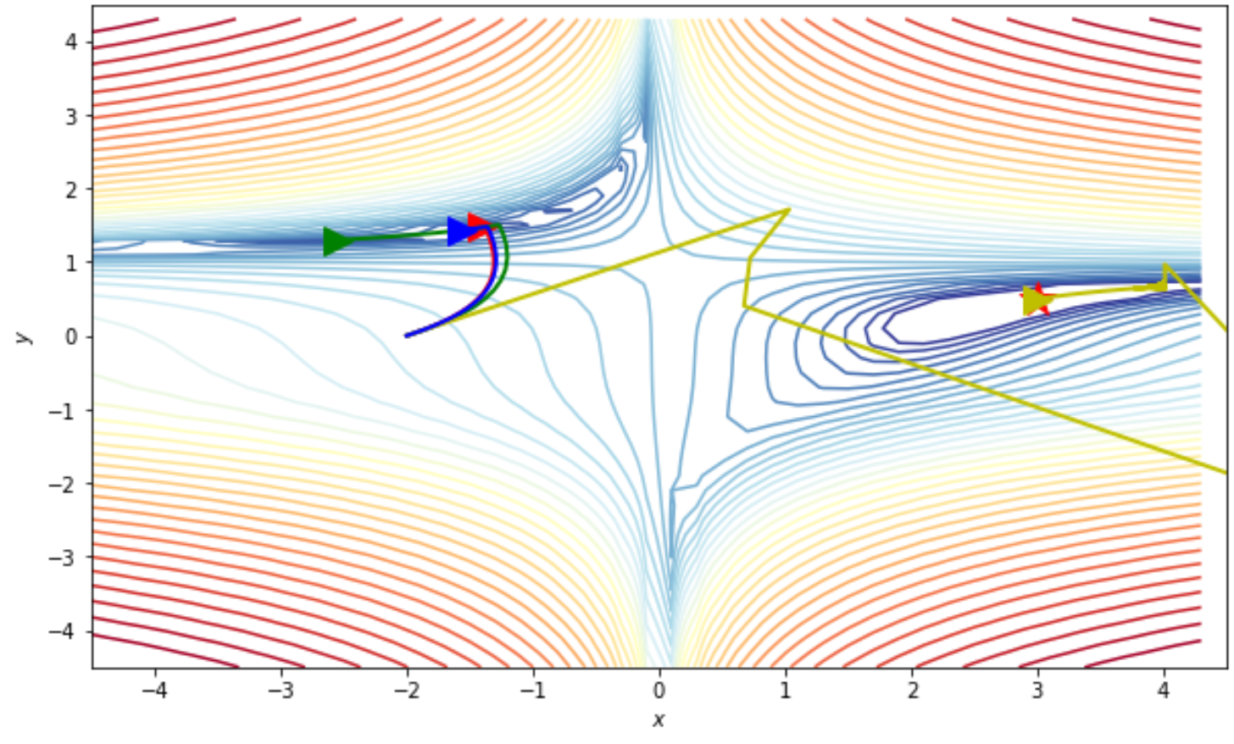
Testing speeds...
Vanilla, RK-2 adaptive L.R., RK-4, NAG
We can notice that regardless of the starting point the RK2 adaptive gradient descent method is outperforming the other methods in every scenario, and manages to reach the absolute minimum of the Beales function where every other method fails (pic 4).
In pic 1 and 3 we can notice the special feature of the RK4 based method, which accelerates along 'plane areas', in particular, if the objective is locally flat around a minimum, by using only gradient information we can obtain a convergence rate of 1/N^p, where p quantifies the degree of local flatness.
NAG seems to perform generally better than vanilla descent.

Slide 6
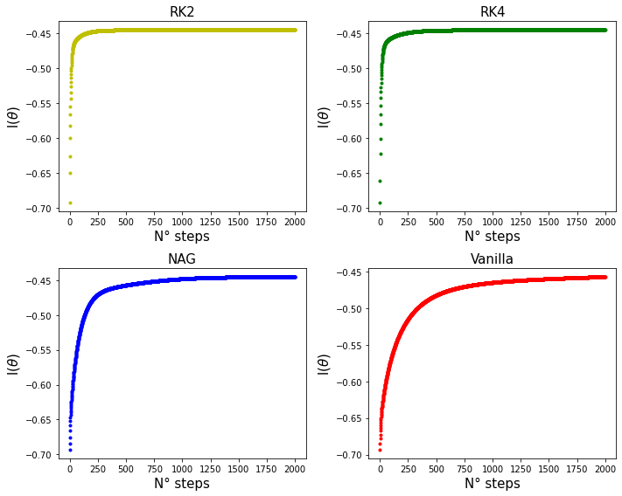
A real application: the Titanic dataset
We have trained each method over a subset of the entire dataset and, after that, we have used another subset to test our methods results. We have converted qualitative feature's classes in "Sex" and "Embarked" features with discrete numeric classes.
Then we compared our results with the real values given by "kaggle" in "gender_submission.csv". We have also recorded the computational time for the machine for each algorithm. We obtained that:
- Vanilla descent accuracy = 0.77
- RK-2 Adaptive L.R. accuracy = 0.76
- NAG accuracy = 0.761
- RK-4 accuracy = 0.763

Slide 7
References
Stochastic Runge-Kutta methods and adaptive SGD-G2 stochastic gradient descent
Imen Ayadi, Gabriel Turinici
https://hal.archives-ouvertes.fr/hal-02483988/file/turinici_ayadi2020-rk-adaptive-sgd.pdf
Direct Runge-Kutta Discretization Achieves Acceleration
Jingzhao Zhang, Aryan Mokhtari, Suvrit Sra, Ali Jadbabaie
https://arxiv.org/abs/1805.00521

